Slide 1
NorTex Petroleum Cluster
Update on CO2 EOR Foam Field Pilots
by
Prof. Arne Graue
Dept. of Physics and Technology
University of Bergen, NORWAY
Rice University's Consortium for Processes in Porous Media, Houston, TX, USA, April 22nd, 2015.

Slide 2
NorTex Partners:
4 Universities in Texas, USA
Rice University, Houston, TX, USA
University of Houston, Houston, TX, USA
University of Texas at Austin, Austin, TX, USA
Texas A&M University, College Station, TX, USA
3 Universities in Norway:
University of Bergen, Bergen, Norway
University of Stavanger, Stavanger, Norway
NTNU, Trondheim, Norway
Industry Board Members
Statoil Petroleum ASA, Schlumberger, OneSubsea
Industry Partners
Denbury, Natl. Oil Well Varco, FMC, Kinder Morgan, Hess, BP, Total,
Oxy, Shell, Wintershall, Tabula Rasa, American Res. and Chevron

Slide 3
Objectives
Strengthen and coordinate petroleum research and education in Norway and Texas
Emphasize industry challenges in academia
How:
Improve communication: industry and academia
Provide industrial lecturers at the universities
Support student and faculty exchange
Assist in facilitating industry funding

Slide 4
NorTex Petroleum Cluster Board Members and Deputies
Elected Chairman of the Board:
Prof. Arne Graue, Dept. of Physics and Technology, U. of Bergen, Norway
Deputy: Prof. Tor Arne Johansen, Dept. of Earth Science, U. of Bergen, Norway
Board Members:
Prof. Tad Patzek, Department Chair, Dept. of Petr. and Geosystems Eng., UT at Austin, TX, USA
Deputy: Prof. Ron Steel, UT at Austin, TX, USA.
Prof. Dan Hill, Department Head, Dept. of Petr. Eng., Texas A&M Univ., TX, USA.
Deputy: Assoc. Prof. David Schecther, Dept. of Petr. Eng., Texas A&M Univ., TX, USA.
Svenn Ferry Utengen, Vice President Unconventional, Texas Area, Statoil, USA.
Deputy: Bruce Tocher, Manager Unconventional Hydrocarbons, Texas Area, Statoil, USA.
Najib Abusalbi, Corporate University Relations Manager, Schlumberger, Houston, TX, USA
Prof. George Hirasaki, Dept. of Chemical and Biomolecular Eng., Rice U., TX, USA.
Deputy: Ass. Prof. Lisa Biswal, Dept. of Chem.. and Biomolecular Eng., Rice U., TX, USA
Prof. Tom Holley, Director, Petr. Eng. Program, U. of Houston, TX, USA.
Deputy: Mike Nikolaou, Assoc. Prof. of Chemical Engineering, University of Houston
Prof. Svein Skjæveland, Dept. of Petr. Eng., U. of Stavanger, Norway
Deputy: Assoc. Prof. Merete Madland, Dept. of Petr. Eng., U. of Stavanger, Norway
Prof. Martin Landrø, Dept. of Petr. Eng. and Applied Geophysics, NTNU, Norway
Deputy: Prof. Ole Torsæter, Dept. of Petr. Eng. and Applied Geophysics, NTNU, Norway

Slide 5
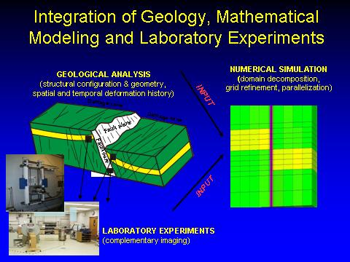
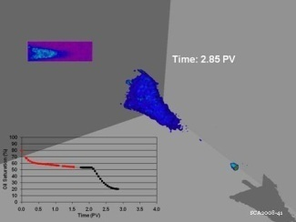
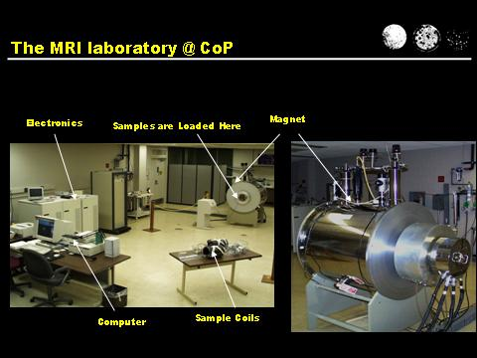
CCUS as EOR:
Integrated EOR (IEOR) for CO₂ Sequestration
CO₂ Foam for Mobility Control for EOR in
Fractured Reservoirs in Texas
Collaboration: 11 Universities in France, The Netherlands, UK, USA and Norway
Coordinator: Arne Graue, Dept. of Physics, University of Bergen, NORWAY
Funding: The Research Council of Norway and oil companies
Lab to pilot field test
MRI of CO₂ injection
Complementary NTI & MRI facilities

Slide 6
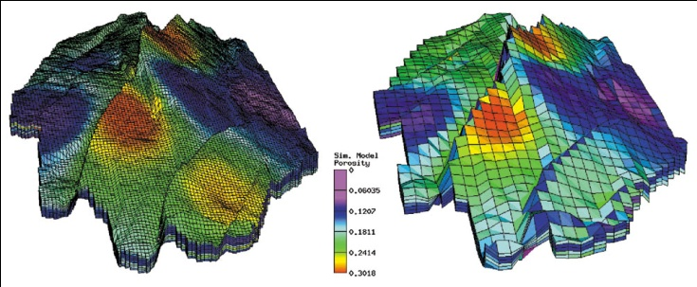
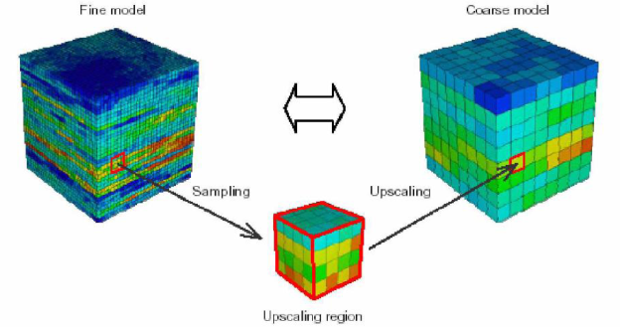
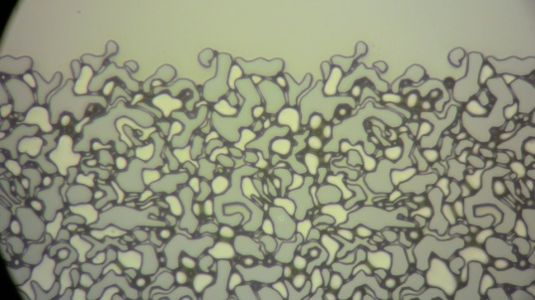
10³-10⁴m
Petroleum Geo-Services Homepage www.pgs.com
10¹-10²m
GRIDBLOCK SCALE
Length Scales
Numerical Simulations
10⁻¹-10⁰m
BLOCKSCALE
Nuclear Tracer
10⁻³-10⁻²m
CORESCALE
Imaging techniques
MRI and CT
10⁻⁵-10⁻³m
MICROSCALE
Microscopy

Slide 7
Project advantages:
- CO₂ is commercially available
- Foam as mobility control
- Researchers from 11 reputational universities
- Up-scaling; major challenge in oil recovery
- Fraction of costs of off-shore field tests
- Fast results: short inter-well distances
- 30 years experience in Texas on CO₂ EOR
- 4D seismic establishes a field laboratory
CO₂ Foam for Mobility Control for EOR in Fractured Reservoirs in Texas

Slide 8
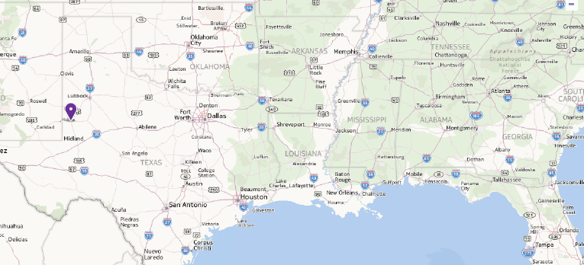

Slide 9
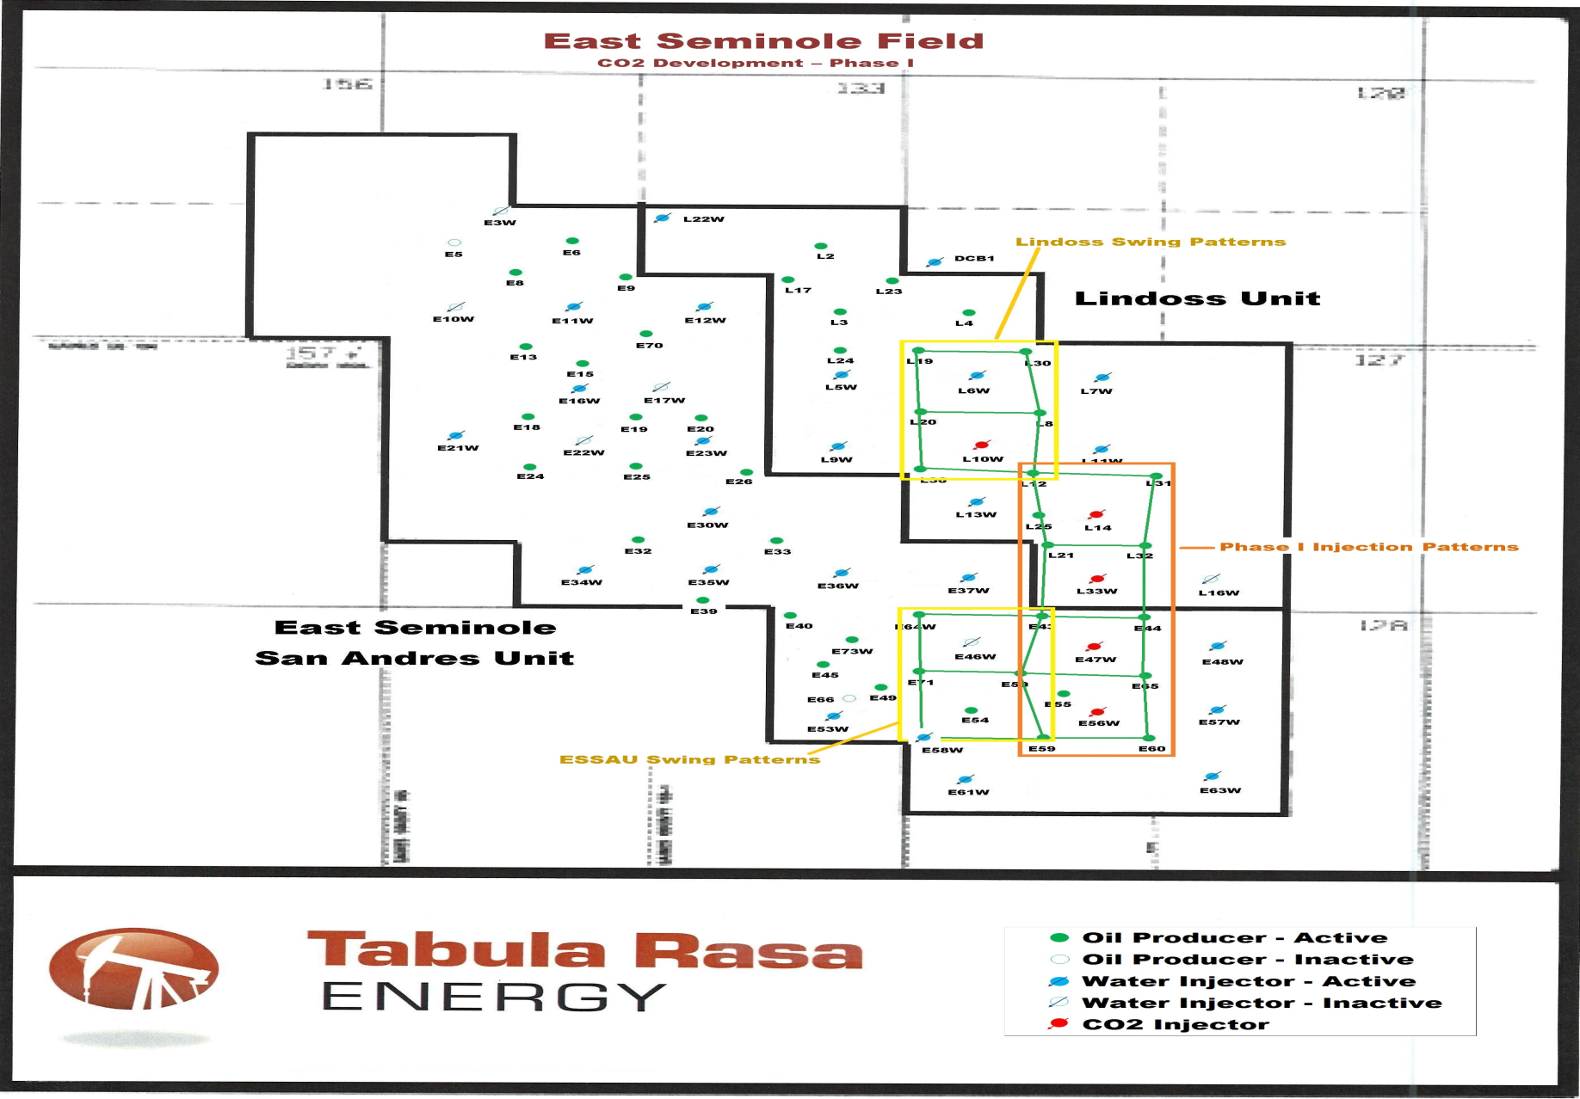

Slide 10
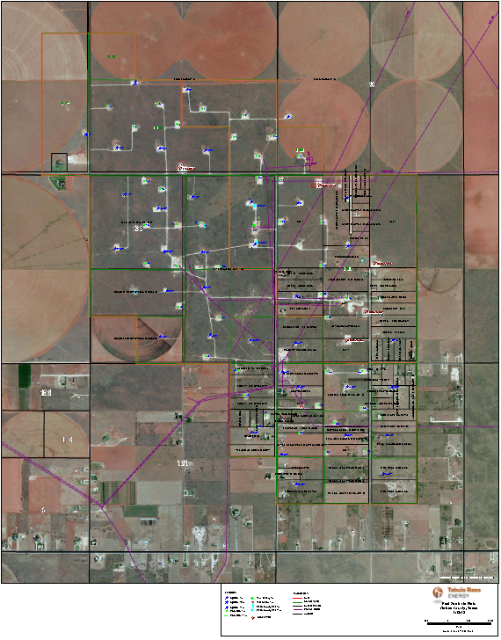

Slide 11
Upscaling:
- Micromodels
- Core Plugs
- Large Volume Blocks
- Grid Block
- Field Pilot Simulations

Slide 12

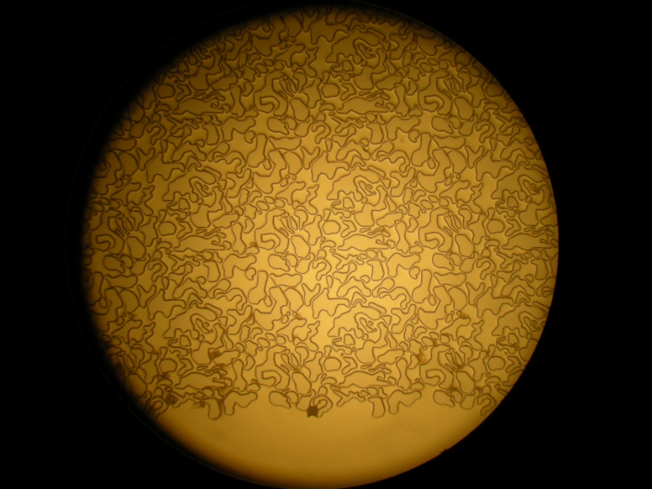
Experimental setup micro model experiments
Closed
Closed
Microscope image
MICROMODEL
Fracture
Porous matrix
Fracture
Fracture
Open
Direction of flow
Open

Slide 13
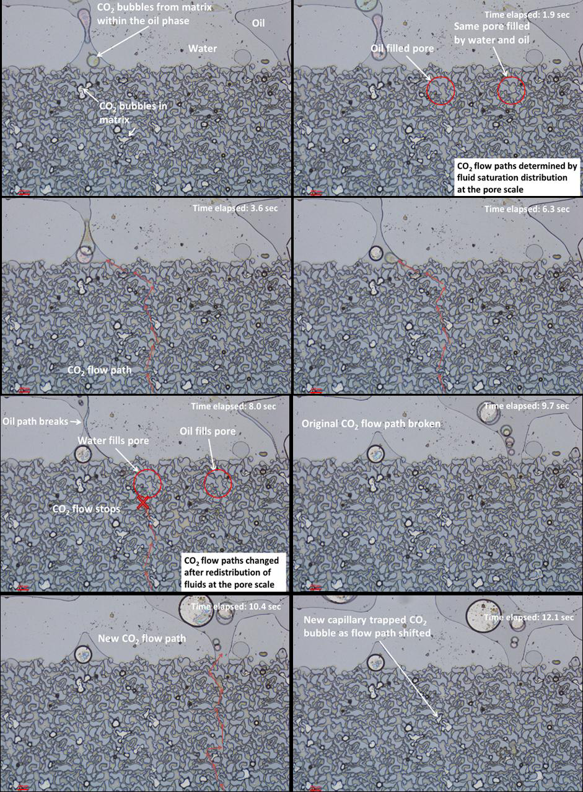
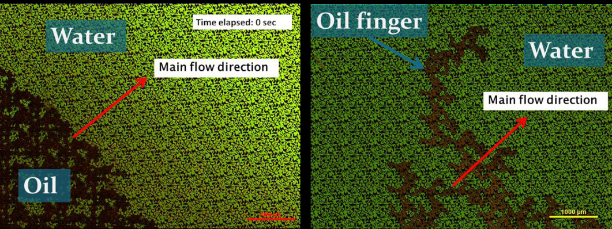
Pore Level Visualization
Above: Impacts from favorable and
unfavorable mobility control at pore level
LEFT: Fracture-Matrix Fluid Interaction
during CO2 injection

Slide 14
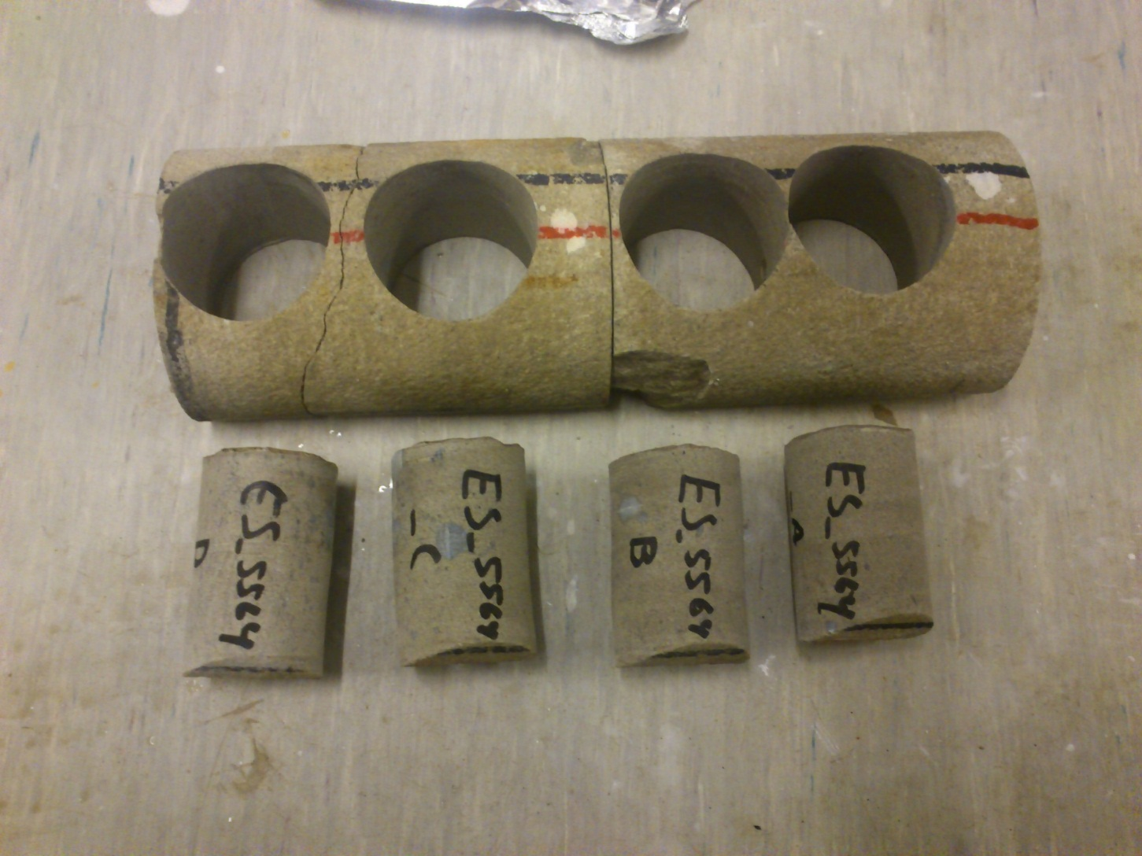
East Seminole Core Plugs

Slide 15
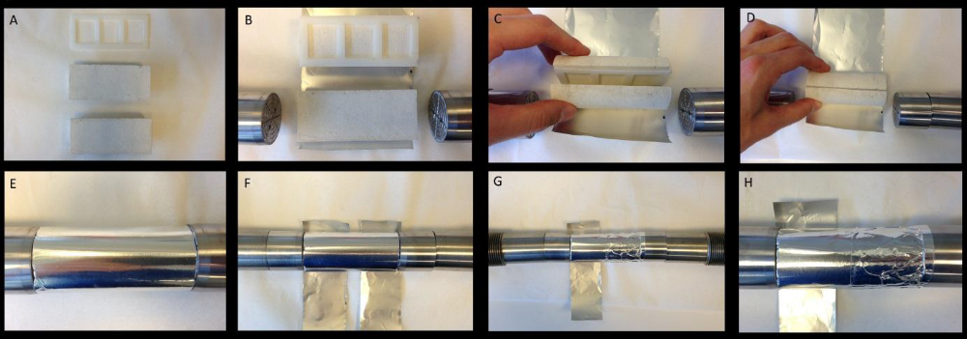
Core Plug Preparation

Slide 16
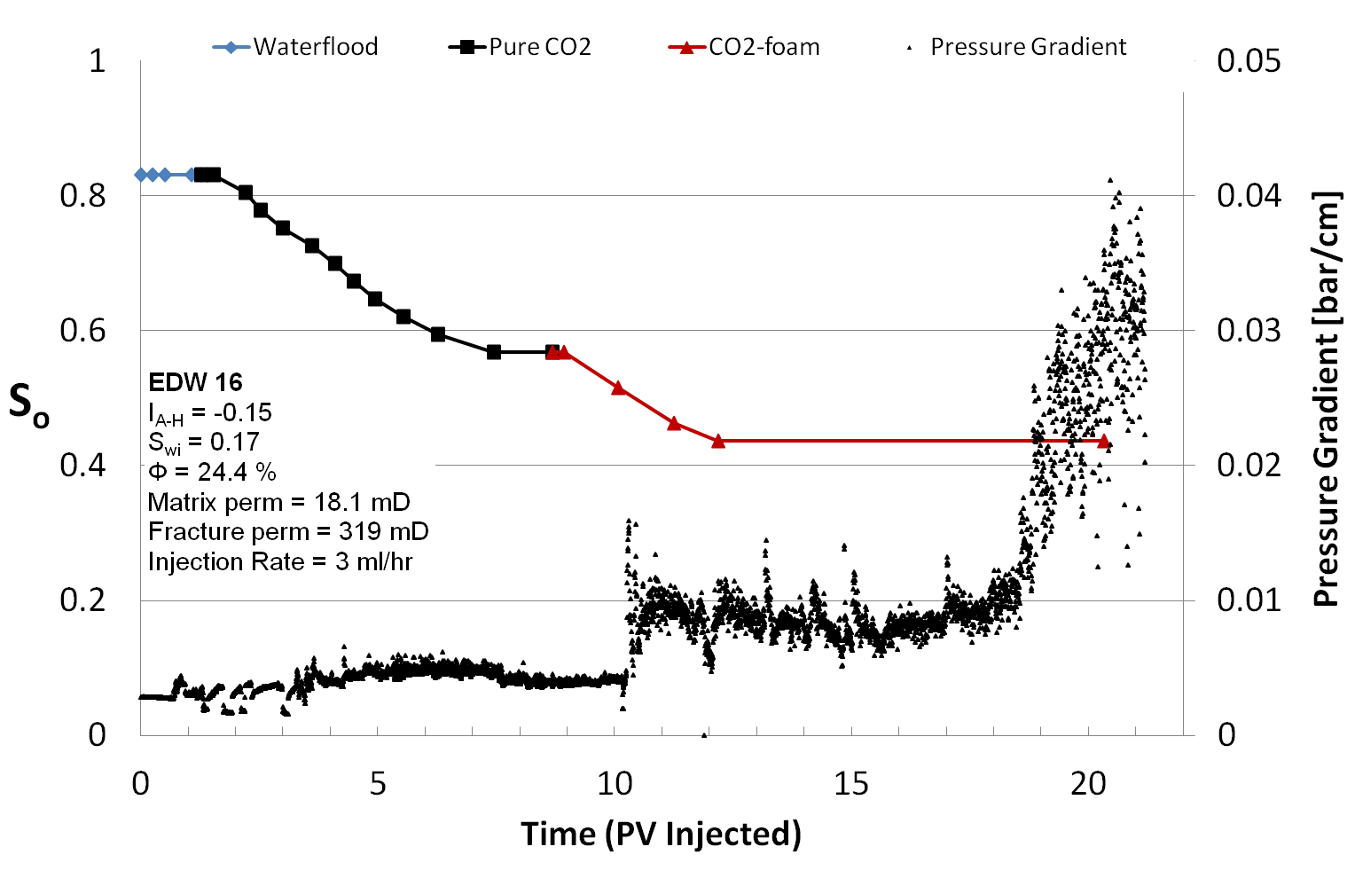
Oil-Wet Carbonate Core Plugs:
IEOR (WF + CO₂ + CO₂-foam)

Slide 17
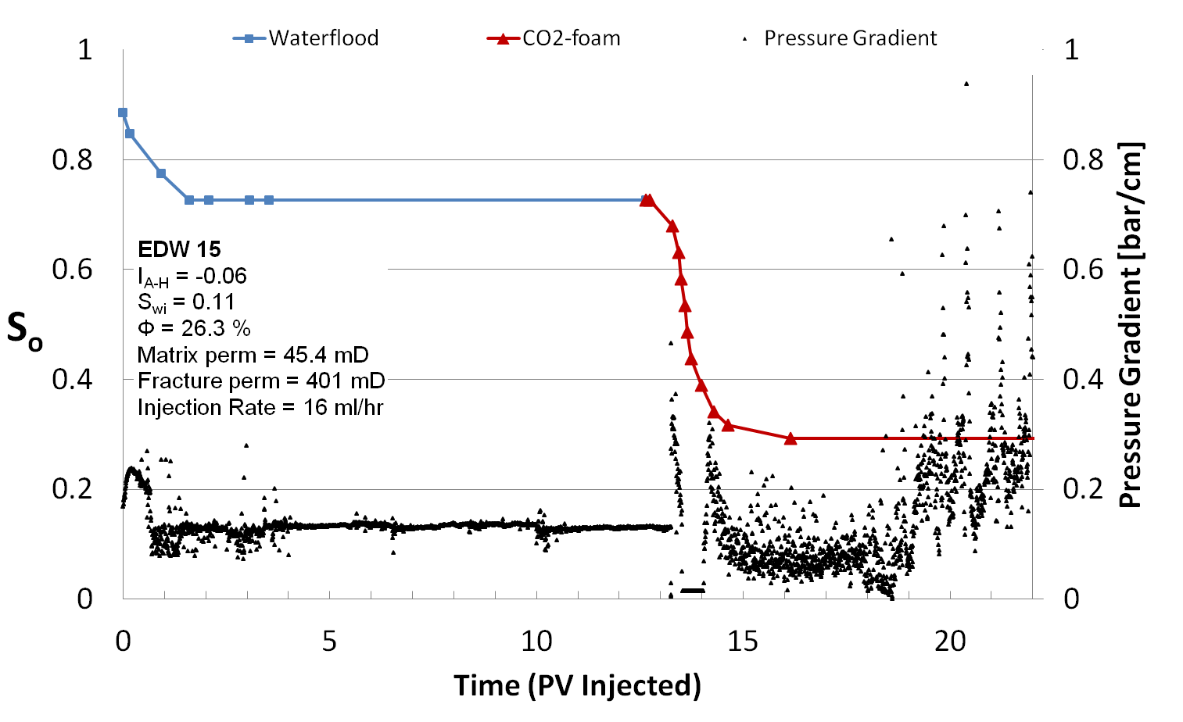
Oil-Wet Carbonate Core Plugs:
IEOR (WF+CO₂-foam)

Slide 18
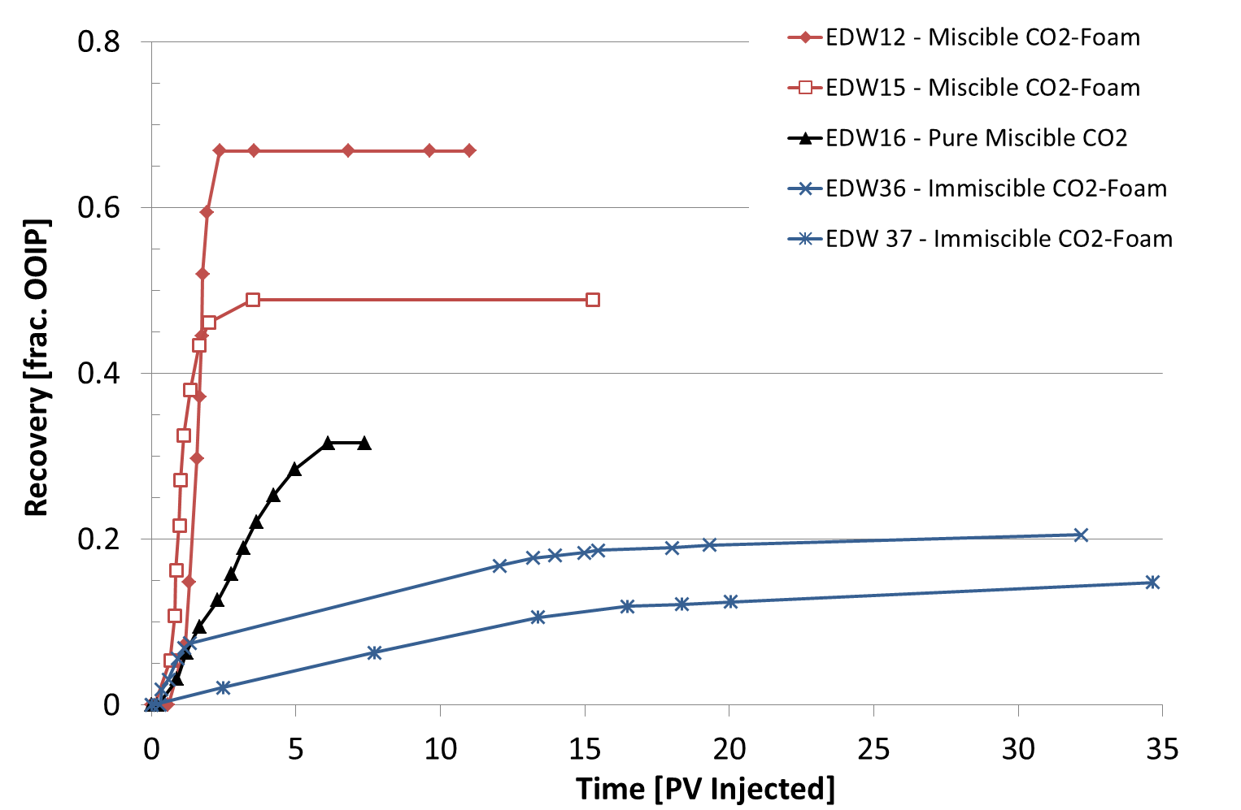
Comparison between miscible CO₂ injection and immiscible and miscible CO₂-foam

Slide 19
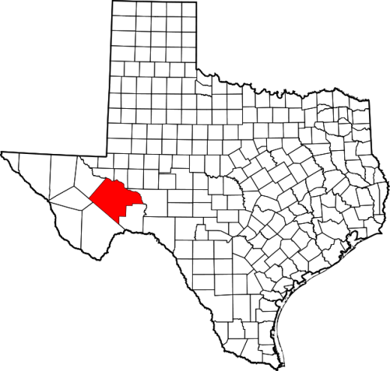
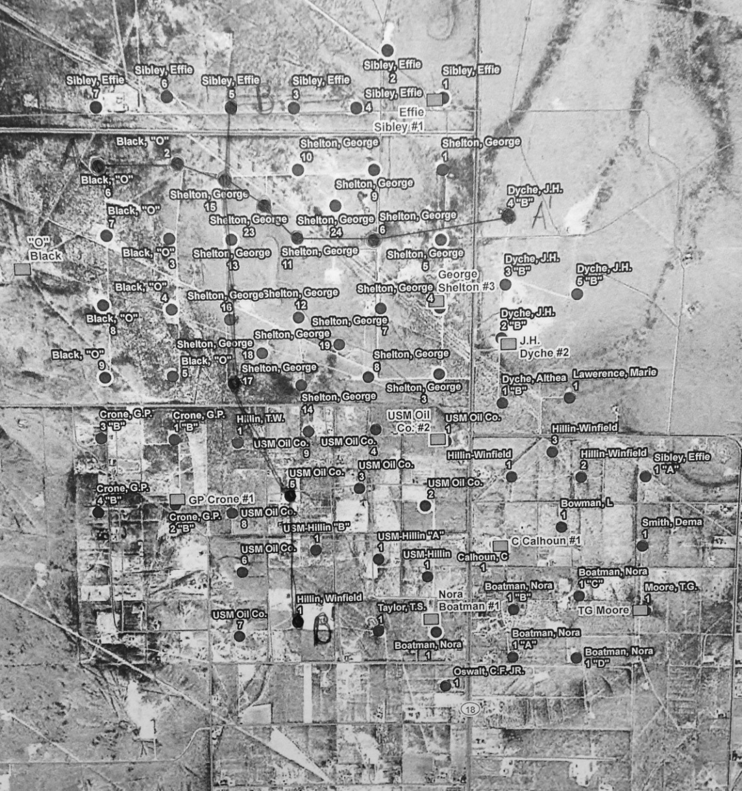
Well Location Map
Notes:
Approx 70 wells

Slide 20
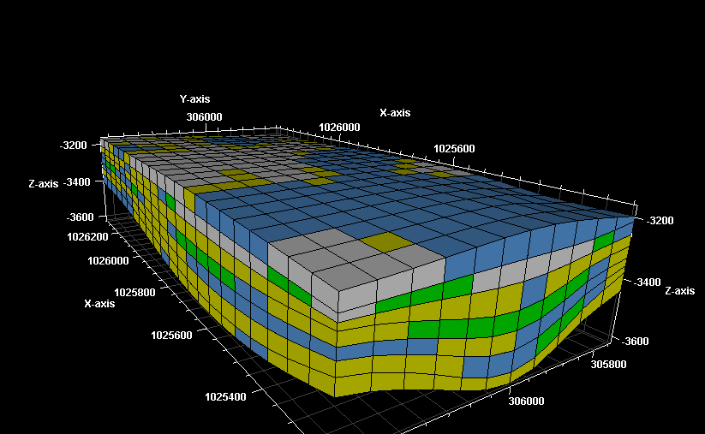
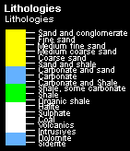
Geologic Model
Lithologies
Notes:
Top carbonate/evaporite seal characteristic of Queen

Slide 21
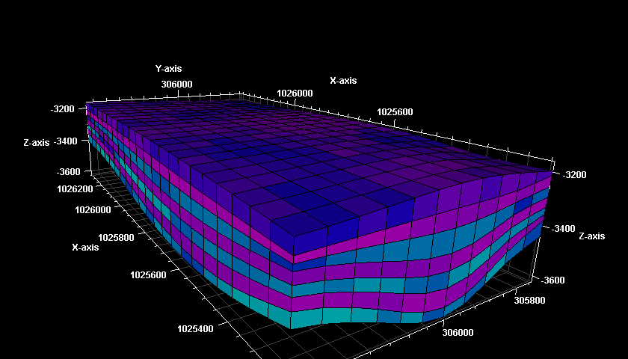

Geologic Model
Petrophysical Properties
Notes:
Shaley layers have decreased poro
Blue zones are targets

Slide 22
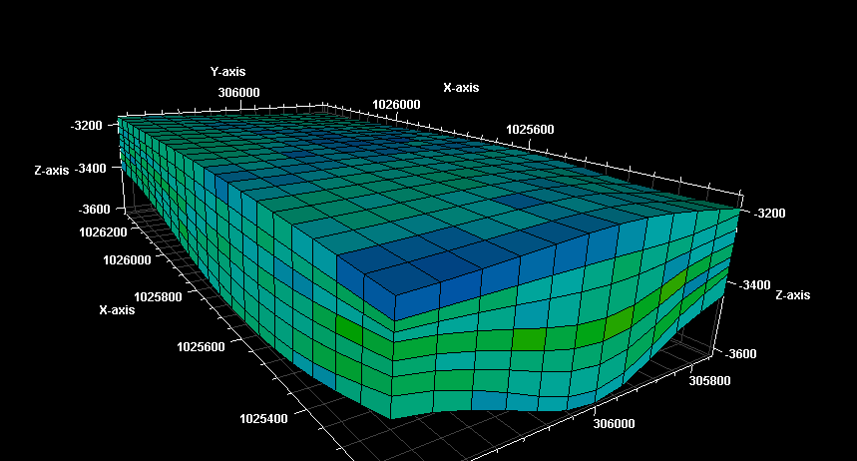
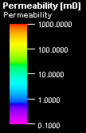
Geologic Model
Petrophysical Properties

Slide 23
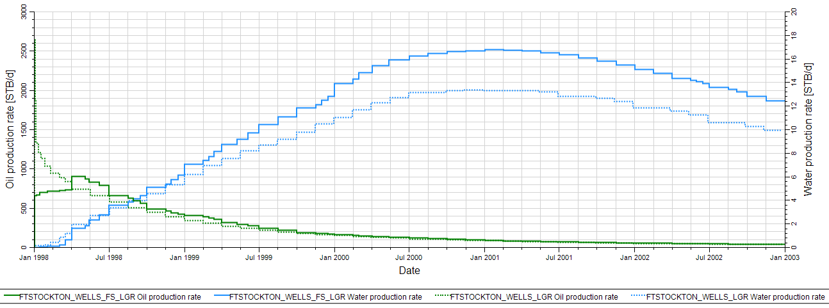
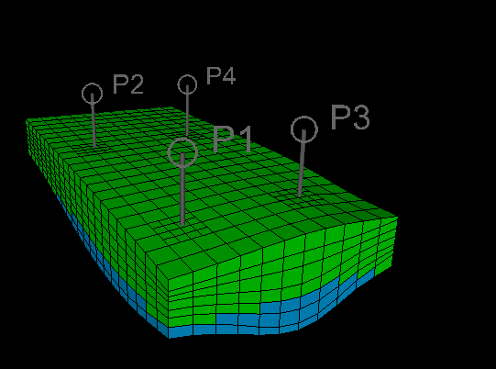
History Matched Model
Oil and Water Production Rates
Notes:
LGRs around wells to enhance resolution of data and to set realistic perforations

Slide 24
Brief status and summary of recent achievements for the East Seminole & Ft. Stockton Field Pilots:
The projects are ongoing using industry and university resources
Suitable surfactant for the foam generation in carbonate selected
Adsorption characteristics determined; negligible absorption
Chemical supplier contacted
All reservoir data for East Seminole are transferred into Petrel
CO2 injection since Oct. 2013; CO2 breakthrough, recycling CO2
3D digital reservoir model obtained for simulation purposes
Similar work completed for the Ft. Stockton field
Schlumberger has provided personnel for the simulation work
Numerical modeling ongoing for history matching previous waterfloods
Confidence in Geological Model before modelling CO2 injection
Work in progress to select best 5-spots for foam injection
Further planned progress:
- Model various CO2 and Foam injection scenarios after HM of WF
Simulation exercises to select the best wells for the Foam Pilot
Modern well logs and/or 3D seismic surveys
SCAL for determining injection strategies

Slide 25
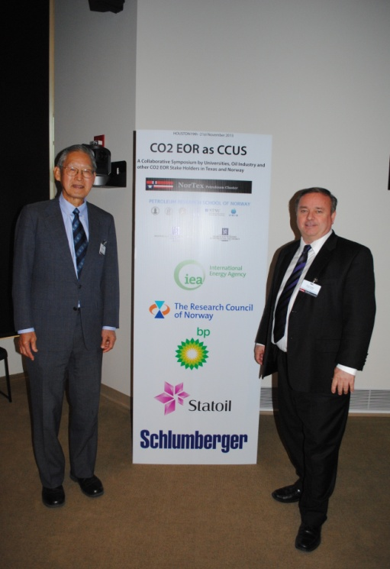
2nd Biennial NorTex and NFiP Conference, Rice University, Oct. 5th & 6th, 2015:
“CO2 for EOR as CCUS”
For 2013 program and published presentations:
www.NorTexpetroleum.org
http://nortexpetroleum.org/co2-eor-as-ccus.html

